Slide 1
Welcome to Week 14, Lecture 02!
Advanced Transformation
with Pandas

Slide 2
Agenda
Local Workflow Review
CodeAlong: Mapping Yelp API Results - Part 2
Applying Advanced Transformations
Quick Project 3 - Part 2 Clarifications
Office Hours: Tackling the Project 3 - Part 2 assignment.

Slide 3
Assignments
This week’s assignments:
Efficient Yelp API Calls (Core)*
Project 3 - Part 2 (Core)*
Applying Advanced Transformations (Core)*
Deadline extended to Sunday at 11:59 PM!
* = You should really be able to complete these after today’s lesson.

Slide 4
Local Workflow Review
Reference Slides

Slide 5
Steps to Start a New Project
Create a new repo
In GitHub Desktop: Click File > New Repository.
Give it a name and choose where to save it.
Open a Terminal/GitBash window in repo’s folder.
In GitHub Desktop > Click the Repository menu > Open in Terminal (or Open in GitBash)
Start Jupyter Notebook:
Type “jupyter notebook” or “jnb” in your terminal/GitBash.
Jupyter Notebook’s File view will open in your web browser.
Create a new notebook:
Click the “New” button in top right corner of Jupyter.
Select “Python (dojo-env)”
Do your work/analysis in your new notebook.

Slide 6
Steps to Finish a Session
In your Jupyter Notebook:
Click File > Save and Checkpoint (or the 💾 icon)
Click File > Close and Halt. Close the web browser tab (if it doesn’t close on its own).
On Jupyter’s File View Page:
Click the Quit button on the top right
Close your browser.
In your GitBash/Terminal:
If the terminal stopped running the notebook and is waiting for input, close the window.
If the terminal is still running jupyter: hit Control + C to force-quit.
Return to GitHub Desktop
Enter a commit message in the “Summary” field on the left sidebar.
Click the blue “Commit” button.
Click “Push Origin”

Slide 7
Steps to Continue Working on a Notebook
Open GitHub Desktop
Click on the “Current Repository” button on the top-left.
Find and click on the repo you want to work on.
===== BELOW ARE SAME STEPS FROM Starting a New Project ====
Open a Terminal/GitBash window in repo’s folder.
In GitHub Desktop > Click the Repository menu > Open in Terminal (or Open in GitBash)
Start Jupyter Notebook:
Type “jupyter notebook” or “jnb” in your terminal/GitBash.
Jupyter Notebook’s File view will open in your web browser.
Create a new notebook:
Click the “New” button in top right corner of Jupyter.
Select “Python (dojo-env)”
Do your work/analysis in your new notebook.

Slide 8
CodeAlong
Mapping Yelp API Results - Part 2

Slide 9
Activity Repository
We will be using the csv of our API results from last class and creating an interactive map.
We will practice many of the advanced transformations steps.
🗺 CodeAlong: Mapping Yelp API Results - Part 2:
Same Repo with new Notebook: “Mapping Yelp Search Results - Part 2.ipynb”
https://github.com/coding-dojo-data-science/data-enrichment-wk14-mapping-yelp-results
📓 04-26-22 Branch with the Notebook Used in Class
If you are adding to your own copy to use your own data, we want to download JUST the new notebook file (see next slide).
If you did not do Part 1, you can use my Baltimore Burger data in the Data folder.

Slide 10
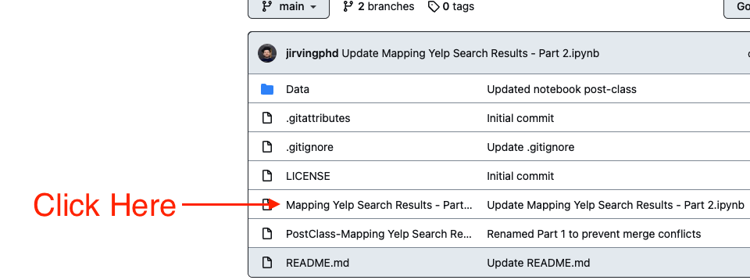
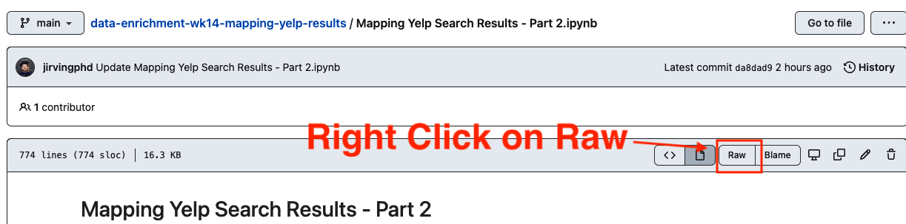
To Download Notebook File - #1

Slide 11
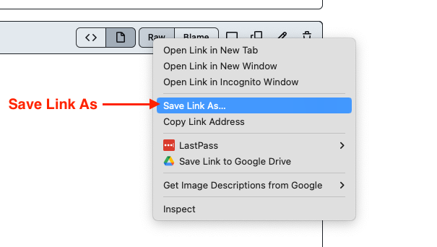
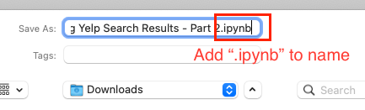
To Download Notebook File #2
Save the notebook link in the same folder as your part-1 notebook
Make sure to add “.ipynb” to file name!!!

Slide 12
Project 3 - Part 2

Slide 13
Quick Clarifications + Tips
PART 2 TIPS:
Make sure to import:
from tqdm.notebook import tqdm_notebook
import time
Functions should be defined BEFORE the loop and then just USED in the loop.
Your EDA should be a quick peek at your results.
Do not worry about cleaning the data and dealing with null values
PART 1 TIPS (for those catching up)
Replacing “\\N” with np.nan requires you import numpy as np (so no “ ” around np.nan)
String methods throw an error if a cell has NaN
(like df[‘Genres’].str.contains(‘Documentary’))
Drop null values from genres before checking for documentary.

Slide 14
End of Lecture

Slide 15
Office Hours: Project 3 - Part 2 Demo
✅ I will record and share the demo.
❌ I will NOT share the notebook.

